Slide 1


POSTER FER-DB Model Enhancement & implementation
POSTER: A Dual-Stream Transformer-Based Architecture for Overcoming Intrinsic Challenges
in Facial Expression Recognition
图像处理- 中国科学技术大学
姓名：
Rawan Ahmed Ameen Hassan
SL22215001
rawan@mail.ustc.edu.cn
Prof. Dong Lanfang
学号：
邮件：
导师：
课堂号：
COMP6207P.01
2023年 11月 日
日期：

Slide 2
Agenda 议程
01
Introduction
02
Methodology
03
Environment Setup
04
Test Results
05
Evaluation & Demonstration
06
Conclusion
07
Thanks

Slide 3
Introduction
Introduction
Fcial expression recognition (FER) stands as a cornerstone in the domain of computer vision, playing a pivotal role in deciphering human emotions and intentions.
This work introduces the ”POSTER: A Pyramid Cross-Fusion Transformer Network,” a novel approach aimed at further advancing the field of FER. This work addresses critical challenges inherent in FER, including high inter-class similarity, significant intra-class variability, and sensitivity to facial scale variations

Slide 4
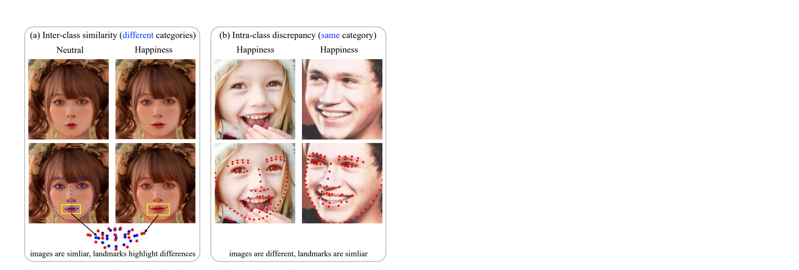
Introduction
contributions
Introduction of the Pyramid cross-fusion Transformer network (POSTER), tailored to effectively tackle inter-class similarity, intra-class discrepancy, and scale sensitivity in Facial Expression Recognition (FER).
Development of POSTER’s cross-fusion transformer structure that synergistically integrates image features, guided by landmark features. This approach emphasizes salient facial regions and leverages the comprehensive global information inherent in image features.

Slide 5
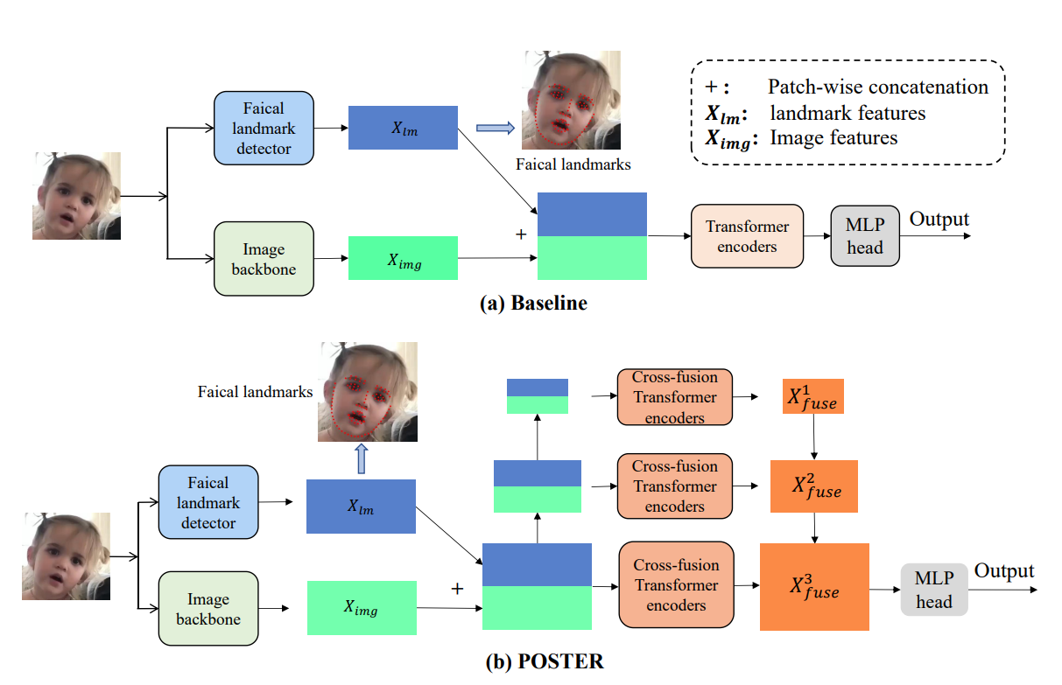
Methodology
Methodology
Baseline and POSTER Framework
Fig.1 Comparison of Architectural Designs: (a) Baseline architecture for FER, and (b) the proposed POSTER model, showcasing advancements in FER technology

Slide 6
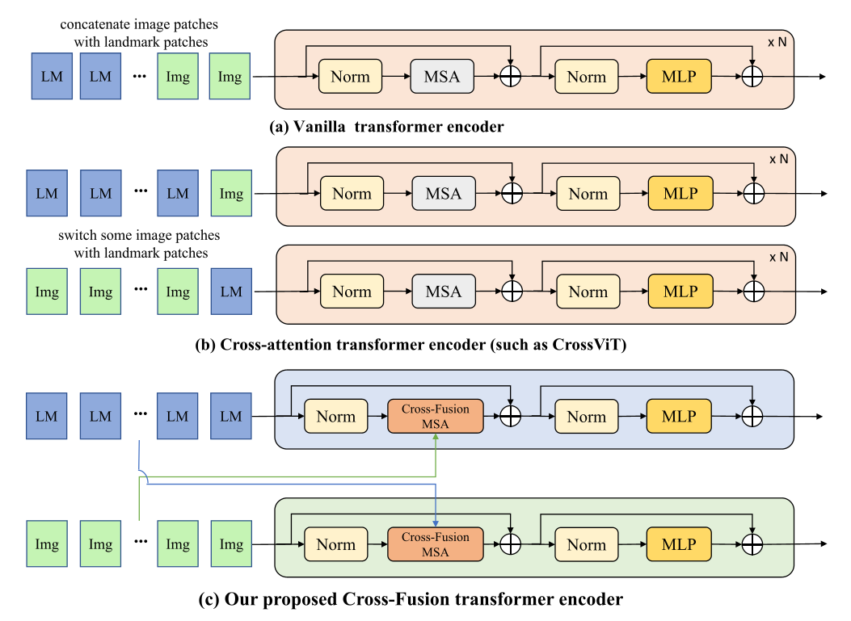
Methodology
Methodology
Baseline and POSTER Framework
Fig. 2 (a) The Standard vanilla Transformer Encoder. (b) Cross-Attention Transformer Encoder. (c) The proposed Cross-Fusion Transformer Encoder.

Slide 7
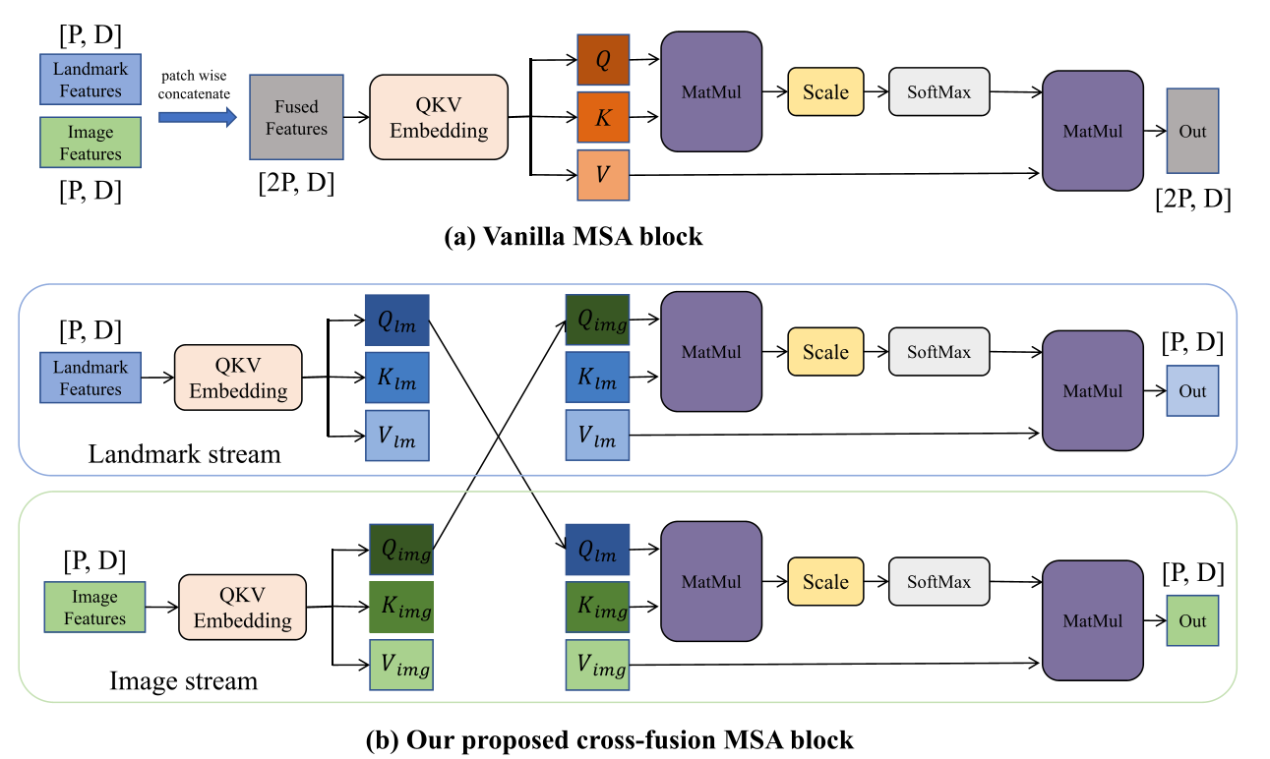
Methodology
Methodology
Baseline and POSTER Framework
Fig. 3 (a) Traditional MSA Block: Displays the standard Multihead Self-Attention (MSA) block used in transformer encoders, where P represents the number of patches, and D signifies the embedding dimension. (b) Cross-Fusion MSA Block: Illustrates our advanced cross-fusion MSA block within the cross-fusion transformer encoder, enhancing feature integration with P indicating patch count and D the embedding size. [15]

Slide 8
Environment Setup
Environment Setup
Conda Environment.
Data Acquisition.
The RAF-DB (Real-world Affective Faces Database) [19] is a comprehensive facial expression dataset comprising 29,672 real-world facial images. These images have been sourced from the Internet, encompassing a wide range of variations in age, gender, ethnicity, lighting conditions, and occlusions. Specifically for FER tasks, the dataset includes 15,339 labeled images, with 12,271 images designated for training and 3,068 for testing. The dataset covers seven basic expressions: happiness, surprise, sadness, anger, disgust, fear, and neutral.
Implementation.

Slide 9
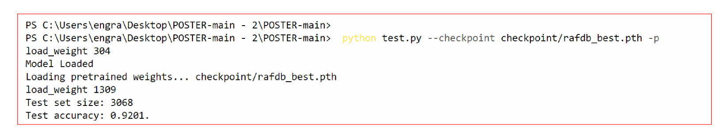
Environment Setup
Environment Setup
POSTER initialization of the model, testing accuracy, and total set size.

Slide 10
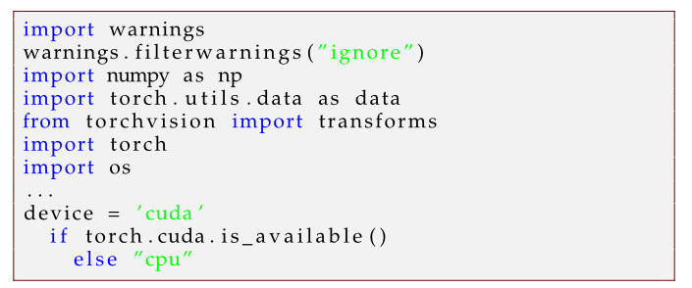
Environment Setup
Environment Setup
Implementation.
Imports and Configuration

Slide 11
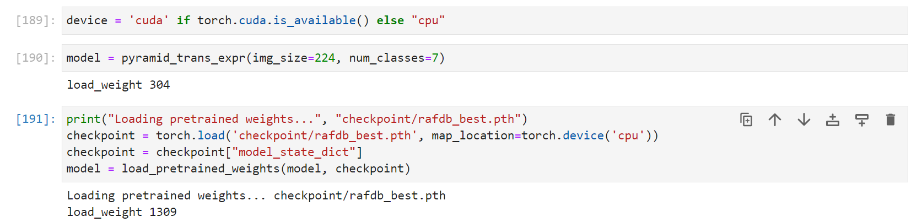
Environment Setup
Environment Setup
Implementation.
b) Model Setup

Slide 12
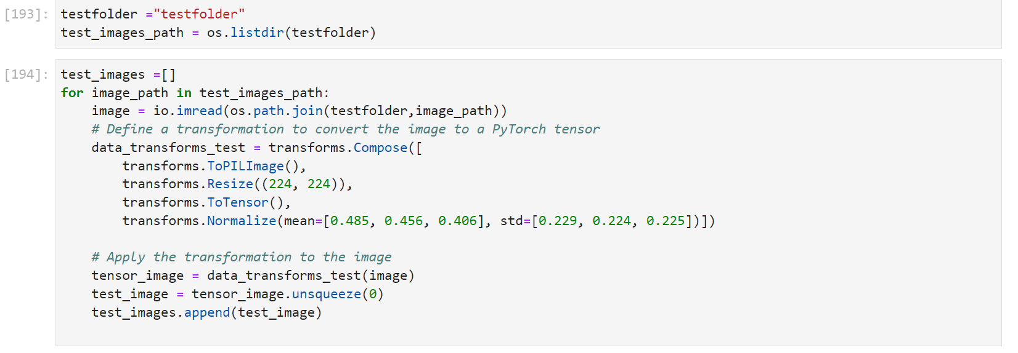
Environment Setup
Environment Setup
Implementation.
c) Data Preparation

Slide 13
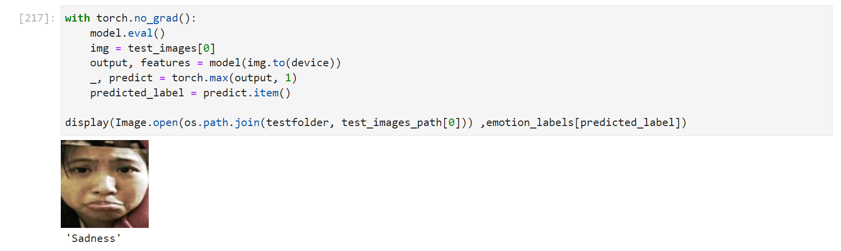
Environment Setup
Environment Setup
Implementation.
c) Model Evaluation

Slide 14
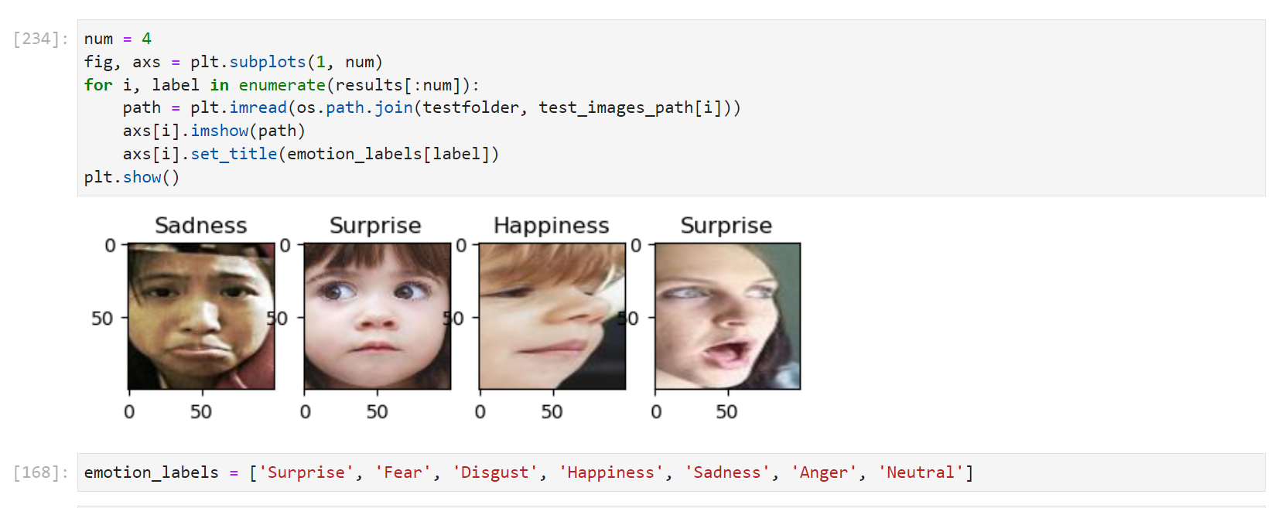
Environment Setup
Environment Setup
Implementation.
d) Results Display

Slide 15
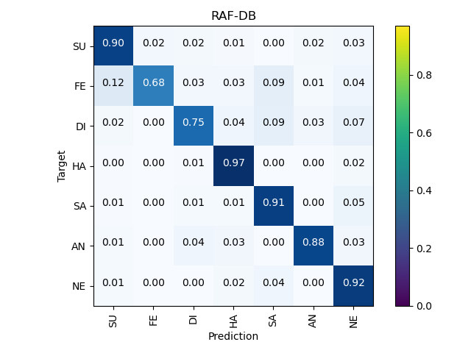
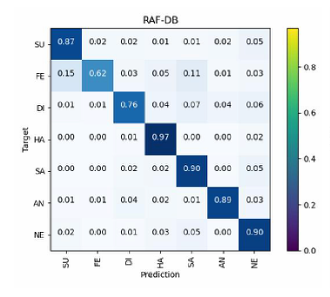
Environment Setup
Environment Setup
Implementation.
c) Display Results :The confusion matrices of baseline and POSTER on RAF-DB
The confusion matrices of POSTER on RAF-DB
The confusion matrices of baseline on RAF-DB

Slide 16
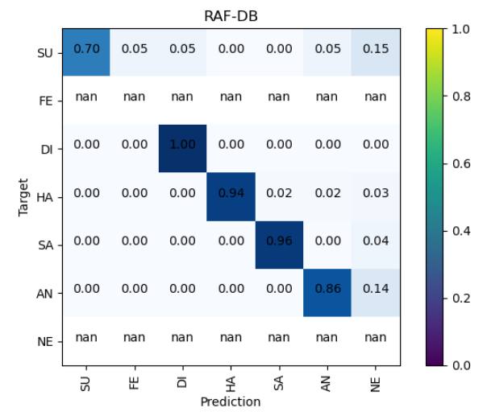
Environment Setup
Environment Setup
Implementation.
c) Display Results :The confusion matrices of baseline, POSTER on RAF-DB, and POSTER on RAF-DB-122
The confusion matrices of POSTER on RAF-DB
The confusion matrices of baseline on RAF-DB
The confusion matrices of POSTER on RAF-DB-122

Slide 17
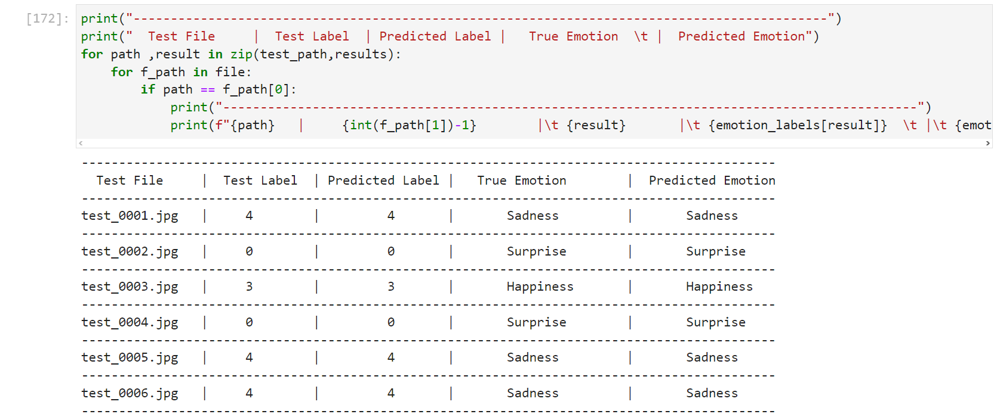
Test results
Environment Setup
Implementation.
c) Display Results :The confusion matrices of baseline and POSTER on RAF-DB
. The result of testing some photos

Slide 18
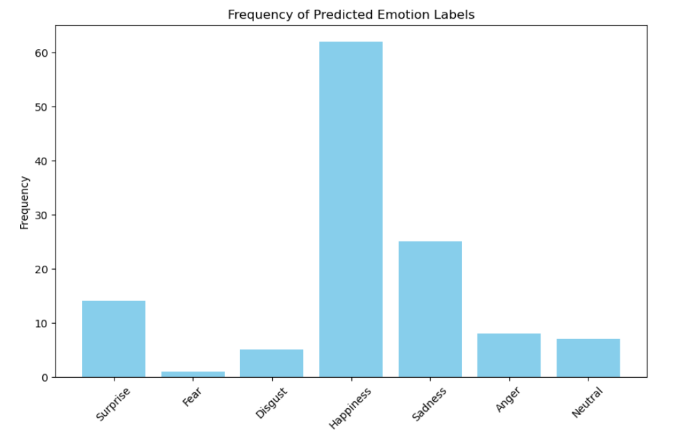
Test results
Environment Setup
Implementation.
c) Display Results :The confusion matrices of baseline and POSTER on RAF-DB
The frequency of predicted emotion labels using POSTER on RAF-DB-122

Slide 19
Test results
Test results
The evaluation phase, subsequent to the meticulous training, loading, and preprocessing of the model, yielded a set of predictions for a test suite encompassing 122 images, as depicted. A subset of these predictions is showcased, delineating the juxtaposition of predicted emotional labels against the ground truth. Furthermore, presents a selection of test images alongside their corresponding true labels. It is noteworthy that the predictive accuracy demonstrated by the model is predominantly high, with correct labels assigned to the majority of test images. Instances of erroneous predictions were observed; however, they constituted a minimal fraction of the test cases, underscoring the model's efficacy in facial emotion recognition.

Slide 20
Test results
Test results
The confusion matrix for a subset of 122 images analyzed using the POSTER technology within the RAF-DB framework, a compelling inference emerges. Notably, the matrix reveals exemplary classification accuracy for emotions such as Disgust, Happiness, and Sadness, with respective values of 1.00, 0.94, and 0.96, indicative of a robust predictive capability. In contrast, the classification of Surprise is characterized by a reduced accuracy of 0.70, coupled with a non-negligible mis-classification with Neutral, underscored by a value of 0.15. When juxtaposed with antecedent confusion matrices for POSTER and baseline algorithms, the POSTER method sustains its superior classification prowess in discernible categories, notwithstanding the absence of data for certain emotions, denoted by 'nan' entries, which precludes a comprehensive comparative assessment.

Slide 21
Evaluation and Demonstration
Evaluation and Demonstration
The performance of the implemented system will be rigorously evaluated against the RAF-DB dataset to determine its accuracy and reliability in various conditions. The evaluation aims to showcase the system's capability in accurately classifying emotional states, thus demonstrating the practical applicability and effectiveness of the algorithm in real-world scenarios.

Slide 22
Conclusion
Conclusion
This study presents a thorough exploration of the Facial Expression Recognition (FER) project utilizing the RAF-DB dataset, highlighted by the deployment of the novel POSTER model. The POSTER model's innovative feature correlation significantly advances FER technology, adeptly overcoming challenges of class discrepancies. Detailed steps for replicating the environment setup were provided, ensuring accessibility for future research and practical applications. An exhaustive code overview was also included, guiding users from initial setup through to evaluation and results interpretation. Ultimately, this study offers a valuable blueprint for researchers and developers in computer vision and machine learning to effectively implement the POSTER model in FER endeavors.

Slide 23

Thanks

